Slide 1
Welcome back to CIVICS!
Notes:
READ FOR LESSON NOTES!!!!!!!!!
[0 min, 0 min total]
Take this time to also remind the students of you and your co-teachers’ names.

Slide 2
Would
You
Rather?
Notes:
READ FOR LESSON NOTES!!!!!!!!!
[5 min, 5 min total]
Take a couple seconds to explain to the students how to play if they are unaware of how to do so.
Typically, one side of the room is dedicated to one answer and the other side is dedicated to the other answer; then students pick the side they want and converse with their classmates. It is a great way to get the kids up and moving early on in the lesson!

Slide 3


Make laws that can never be changed
Make rules that can be changed whenever the President wants
Notes:
[5 min, 5 min total]

Slide 4
What is
The Constitution
Notes:
READ FOR LESSON NOTES!!!!!!!!!
[0 min, 5 min total]
We are going to talk about the Constitution so now we are going to sample what students already know

Slide 5

Think, Puzzle, Explore
What do you think you know about the Constitution?
What questions or puzzles do you have about the Constitution?
Notes:
READ FOR LESSON NOTES!!!!!!!!!
[8 min, 13 min total]
Feel free to pair up students however works best for your classroom. Give them 3 minutes to brainstorm as many ideas as possible and if feasible, have them write them down on a piece of paper or the white board. Afterwards, for five minutes, have different groups share out what they said and compile a list at the front of the board

Slide 6
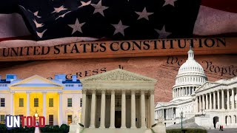
The Constitution
What is the Constitution
How did it come to be?
Notes:
READ FOR LESSON NOTES!!!!!!!!!
[6 min, 19 min total]
Play the video, then have them break into small groups to discuss these questions

Slide 7
1787?? Thats 250 years ago!
How do we
amend (change)
the Constitution?
Notes:
READ FOR LESSON NOTES!!!!!!!!!
[1 min, 20 min]
Pose this question, also ask them why it might be important to change the constitution
Read out the quote. This quote operates from the perspective that environmental justice is a human right!
Quote from: https://www.dcareaeducators4socialjustice.org/news/teaching-environmental-justice-in-early-childhood

Slide 8
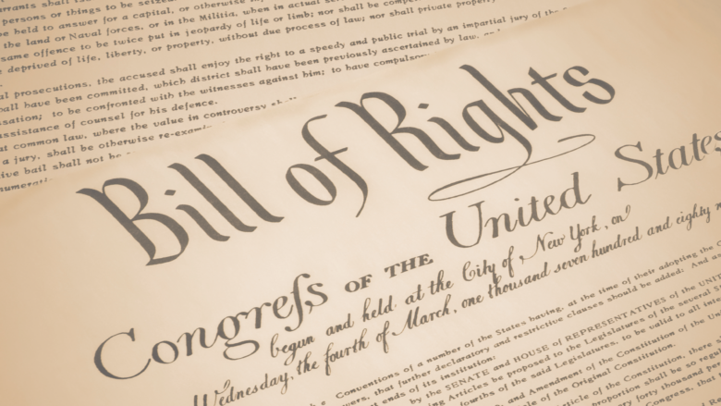
Amendments
An Amendment is a change/addition to the Constitution
The first ten amendments to the US Constitution are called the Bill of Rights
Does anyone know any of the amendments in the Bill of Rights?
Notes:
READ FOR LESSON NOTES!!!!!!!!!
[1 min, 22 min total]
Read this slide as a summary of the previous

Slide 9
How are Amendments made?
Proposal: Amendments can be proposed by a ⅔ vote in Congress or a national convention made up of ⅔ of the 50 states
Ratification: individual states need to agree that they want the Amendment: it must be ratified (agreed on) by ¾ of states through their legislatures (rulebooks) or a convention (meeting of state leaders)
Notes:
READ FOR LESSON NOTES!!!!!!!!!
[1 min, 23 min total]
Read slide, ask if they have any questions

Slide 10

Thumbs check in
How much are you picking up what we are putting down?
Any questions?
Notes:
READ FOR LESSON NOTES!!!!!!!!!
[2 min, 25 min total]
Have them stretch and then use their thumbs to indicate comprehension (tie in a break/social activity here)

Slide 11
NOT RATIFIED! Child Labor Amendment
Section 1.
The Congress shall have the power to limit, regulate, and prohibit the labor of persons under eighteen years of age.
The government can control if/when kids can work
Section 2.
The power of the several States is unimpaired by this article except that the operation of State laws shall be suspended to the extent necessary to give effect to legislation enacted by the Congress.
States have power to decide on their own unless it impacts the rules made by Congress
Notes:
READ FOR LESSON NOTES!!!!!!!!!
[2 min, 25 min total]
Read slide, ask if they have any questions

Slide 12
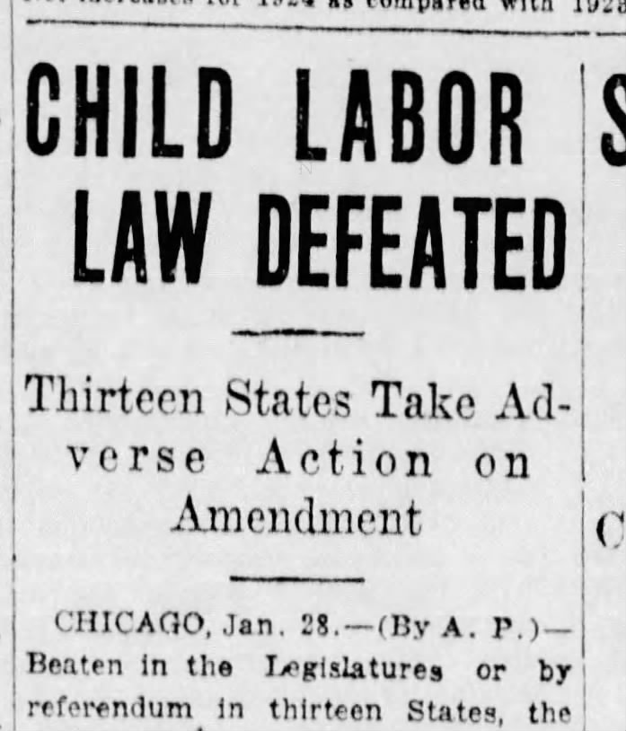
NOT RATIFIED! Child Labor Amendment
What is something that surprises you about this Amendment?
Why do you think it wasn’t it ratified?
Notes:
Not doREAD FOR LESSON NOTES!!!!!!!!!
[5 min, 30 min total]
Have them discuss the questions

Slide 13

RATIFIED! The Nineteenth Amendment
What is something that surprises you about this Amendment?
What is something that makes sense about this Amendment?
Notes:
Not doREAD FOR LESSON NOTES!!!!!!!!!
[10 min, 40 min total]
Play the video. Them have them break up into small groups and discuss the questions

Slide 14
What about the rest of the amendment proposals?
Notes:
READ FOR LESSON NOTES!!!!!!!!!
[2 min, 42 min total]
Read the slide
https://www.ducksters.com/history/us_constitution_amendments.php

Slide 15
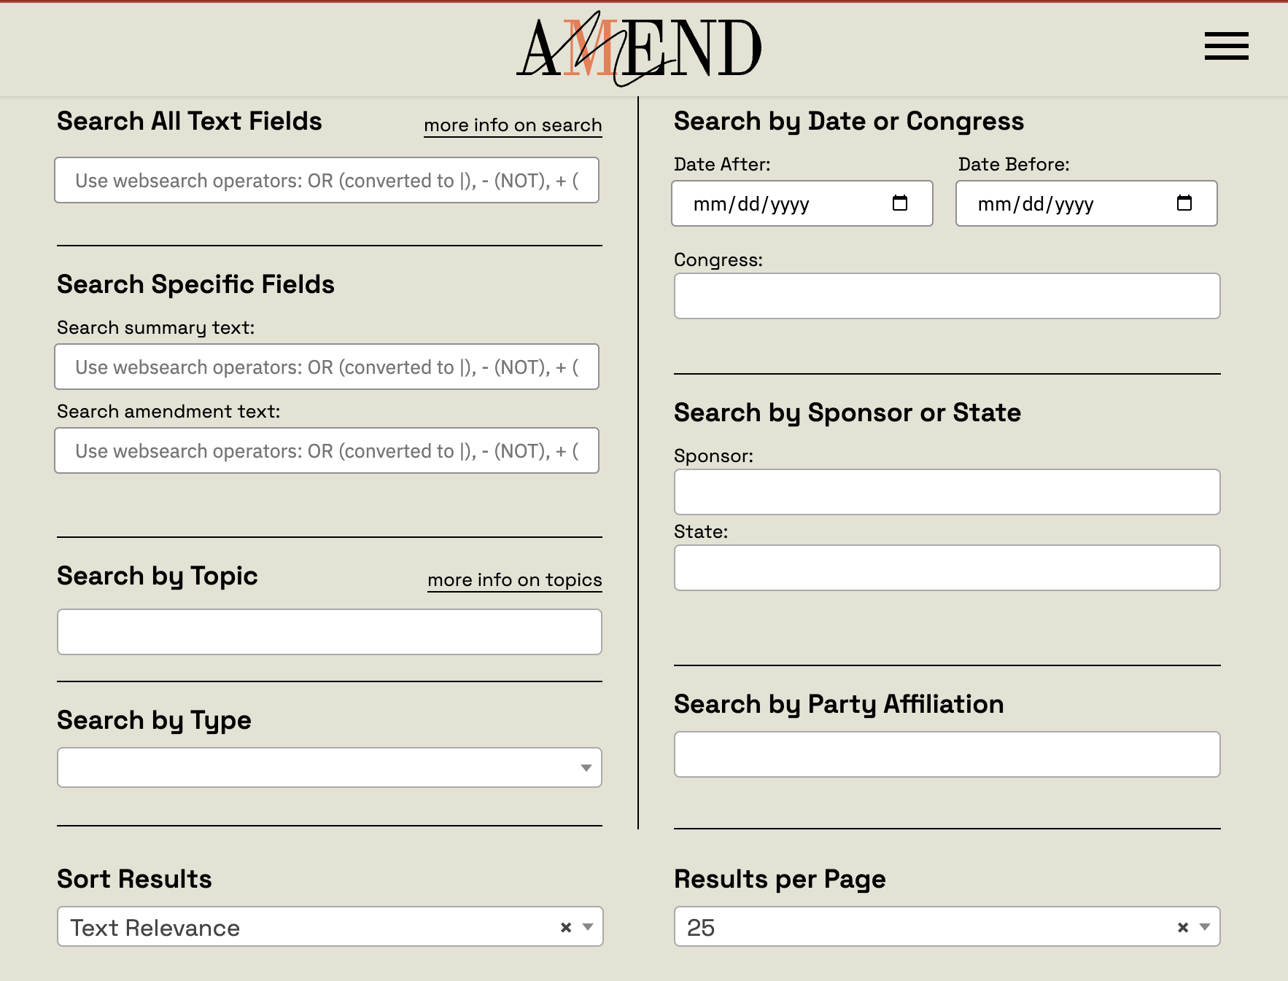
The Amendments Project!
Searchable Archive of every change anyone’s ever tried to make to the constitution!
More than 11,000 amendments have been introduced!
Notes:
Not done yet

Slide 16
Bingo!
Notes:
READ FOR LESSON NOTES!!!!!!!!!
[15 min, 60 min total]
Use this link to play the bingo for the rest of class!

